Slide 1


Oriental College of Technology
Department of Computer Science
(recipe searching and sharing site)
Guide:
Asst. Prof. Syed Rameez Ali
Developed by:
GROUP 05
Moulsiri Awasthi (0126CS191062)
Pranjul Mishra (0126CS191076)

Slide 2
Modules
MODULE 01 :
Idea
Planning
System requirements
Prototype design
MODULE 02 :
(Front end part)
UI design
Developing with html5 css3 and Javascript
MODULE 03 :
(Back end part)
MODULE 04:
(deployment part)

Slide 3
Introduction
“A recipe has no soul. You as the cook, must bring soul to the recipe.”
-Thomas Keller
Finding recipes with all ingredients available at home is difficult some time. Like we always choose a dish and than go to market for it’s ingredients but think of the situation when we have some ingredients at home and we want to make some interesting meal from them. That creates a lot of confusion to what to make . Our site AAHAR solve this problem, it will provide different unique recipes of your test made with all those ingredients which you want to add. It will also give you the feel of social media, that you can add yours too and like and save your fav cook’s recipes.

Slide 4
Objective: Social media site for only recipes, in which user can create their profile, share their own recipes in the form of text and video and last but not least anyone can find it.
Intended Audiences: Woman, children, students and anyone who want to cook some unique taste with the ingredients available in there home that is (no need to go outside to buy)
Project Scope: Right now we don’t expect much users for our site, so it’ll has an interactive front end with features like anyone can login, sign up, create there profile, upload there recipes in form of text, search all that uploaded recipes.

Slide 5
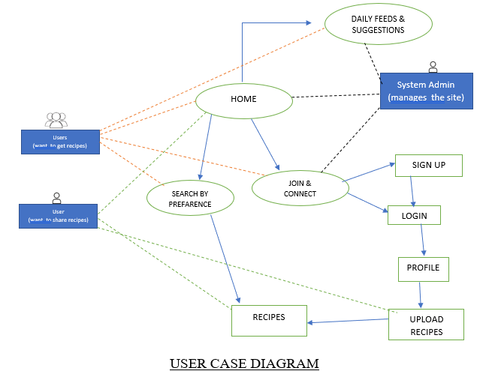

Slide 6
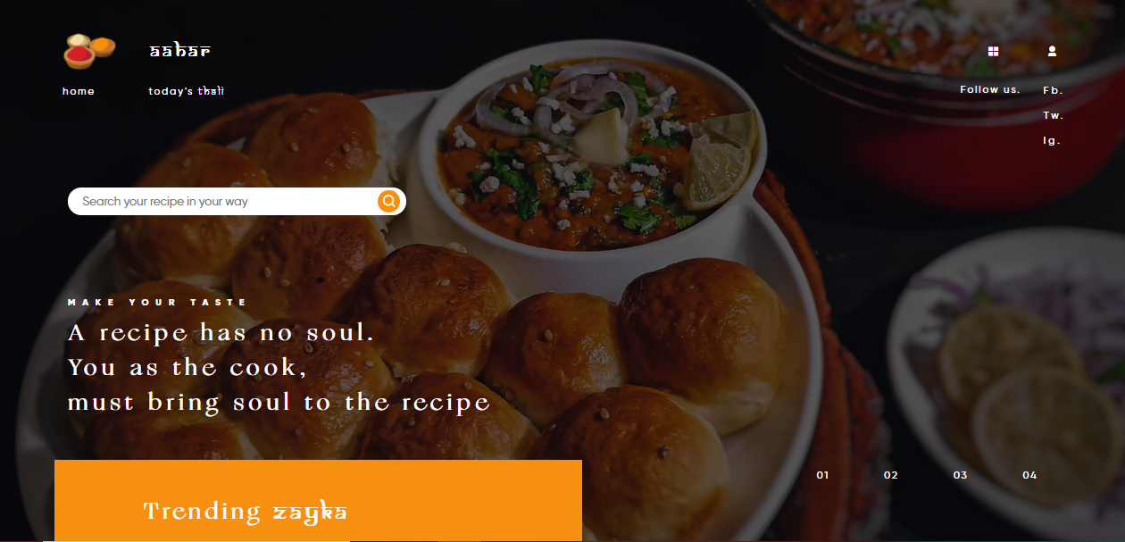
Home page view

Slide 7
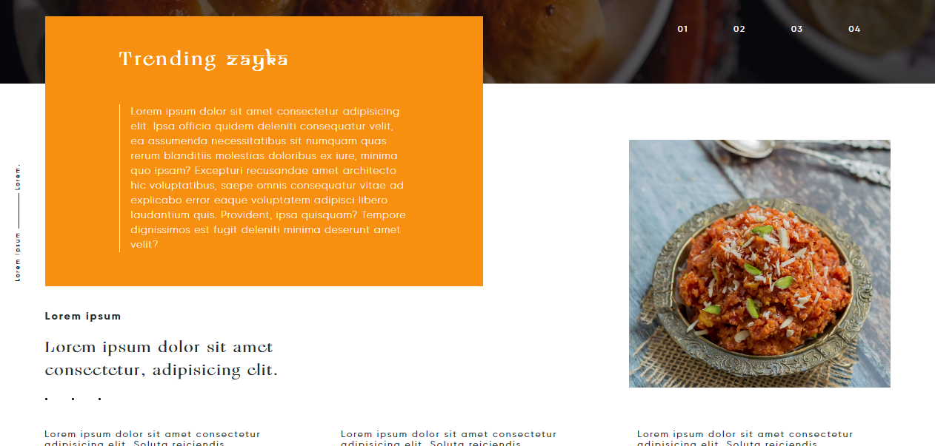
Daily feeds

Slide 8
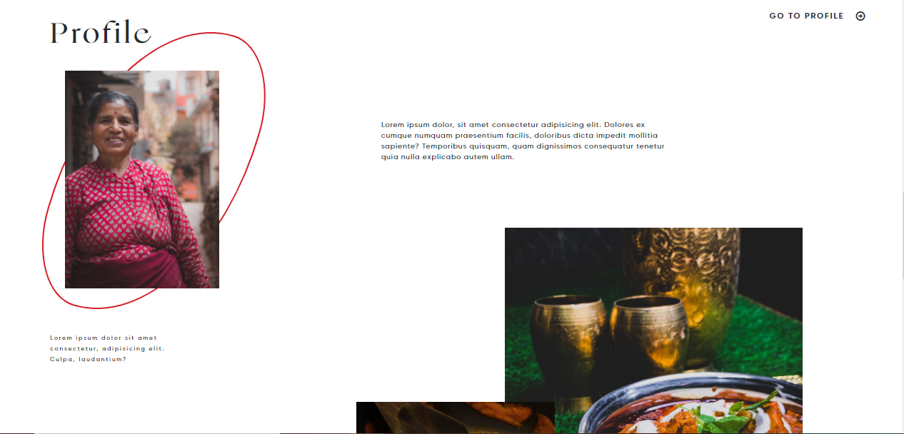
Profile

Slide 9
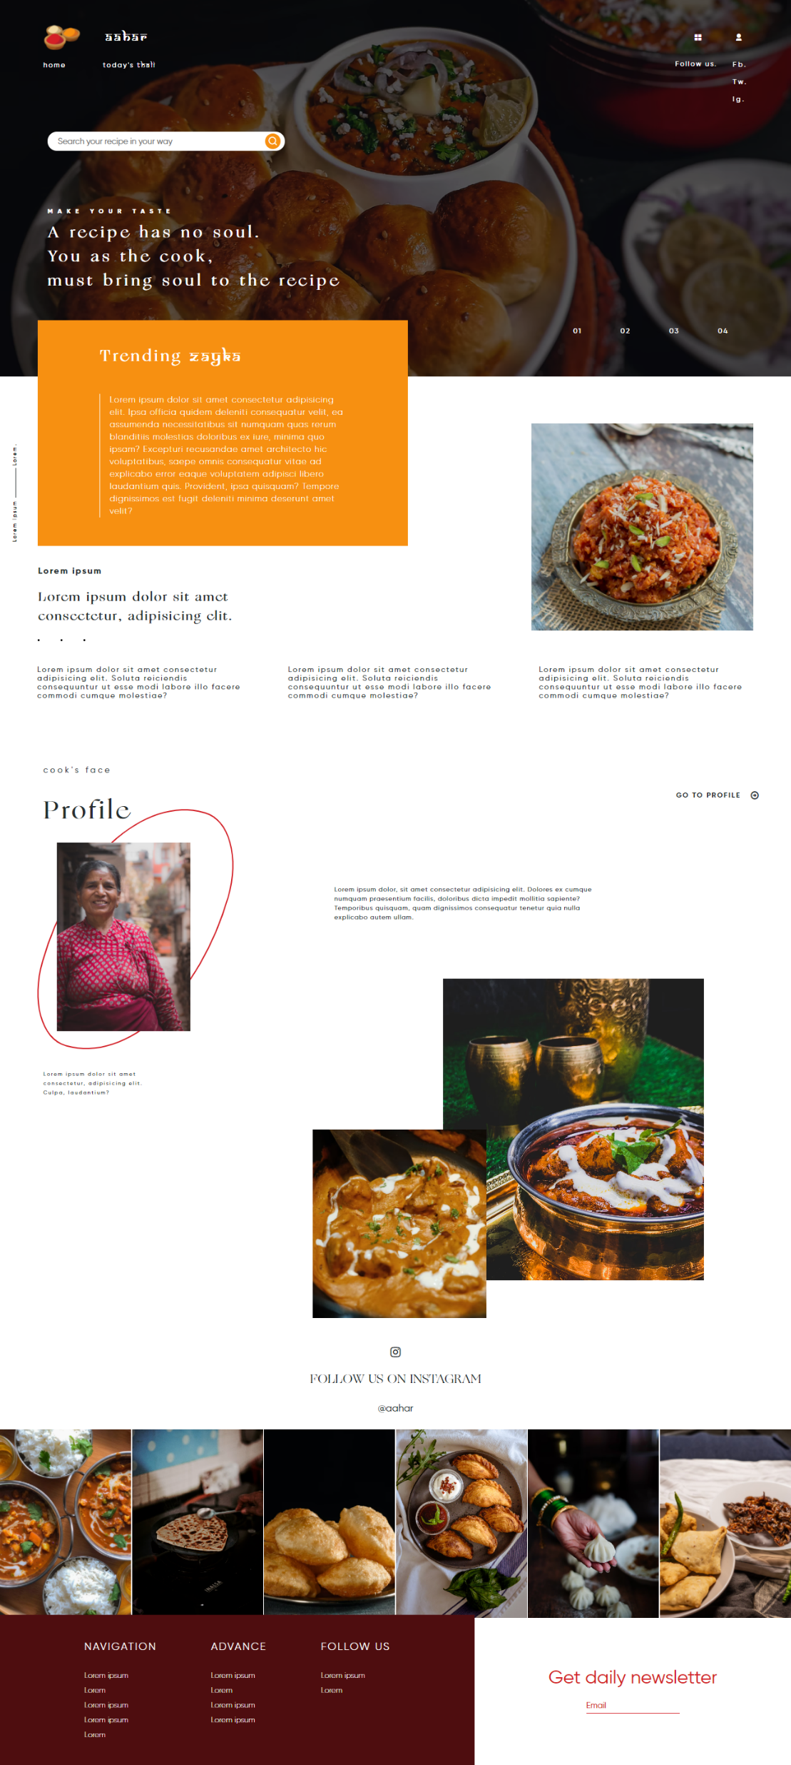
Full desktop view

Slide 10
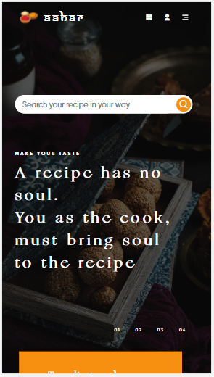
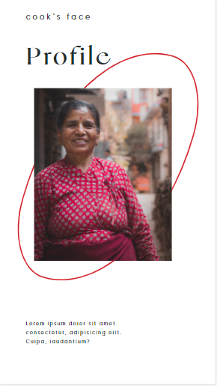
Mobile view

Slide 11
Thank you

